Slide 1
DiD2: Differential Exposure
UIUC ECON 474 Econometrics of Policy Evaluation

Slide 2
Next time: Read chapter 9.6
Today
Providing evidence for parallel trends
Placebo checks
Differential exposure difference-in-differences
“The Role of High-Skill Labor Demand on Spatial Income Inequality: Evidence from the Dotcom Bubble”

Slide 3
Parallel trends
Another instance of unobservable counterfactuals

Slide 4
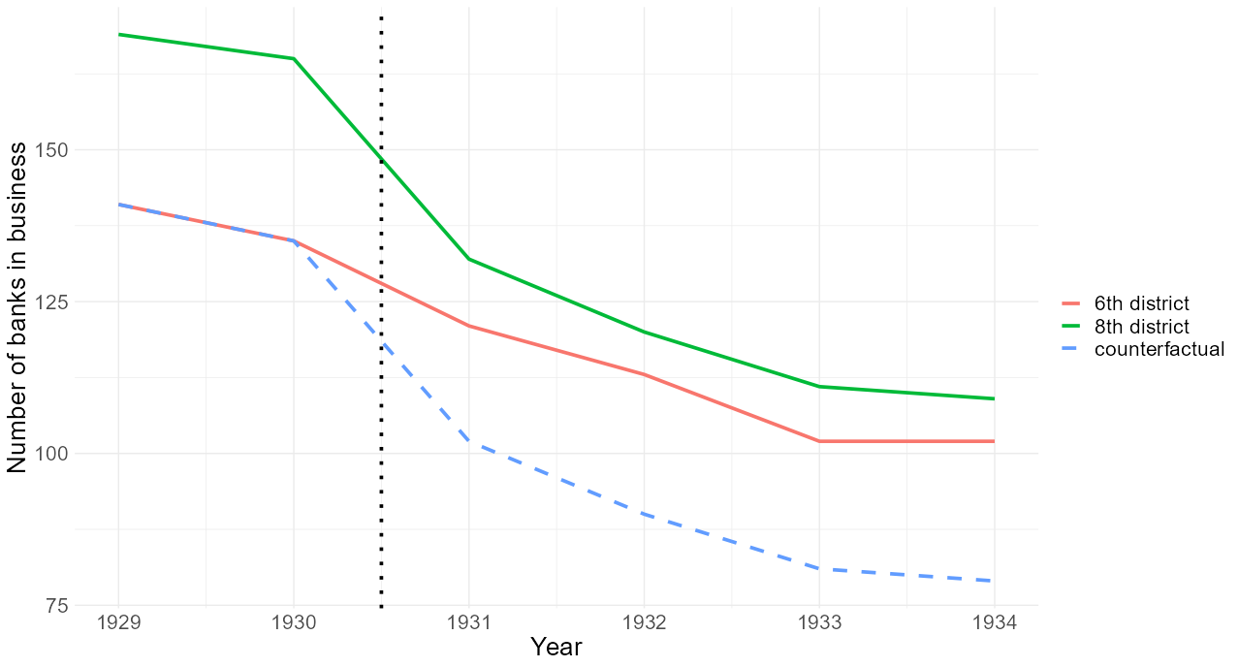
Counterfactual parallel trends are unobservable

Slide 5
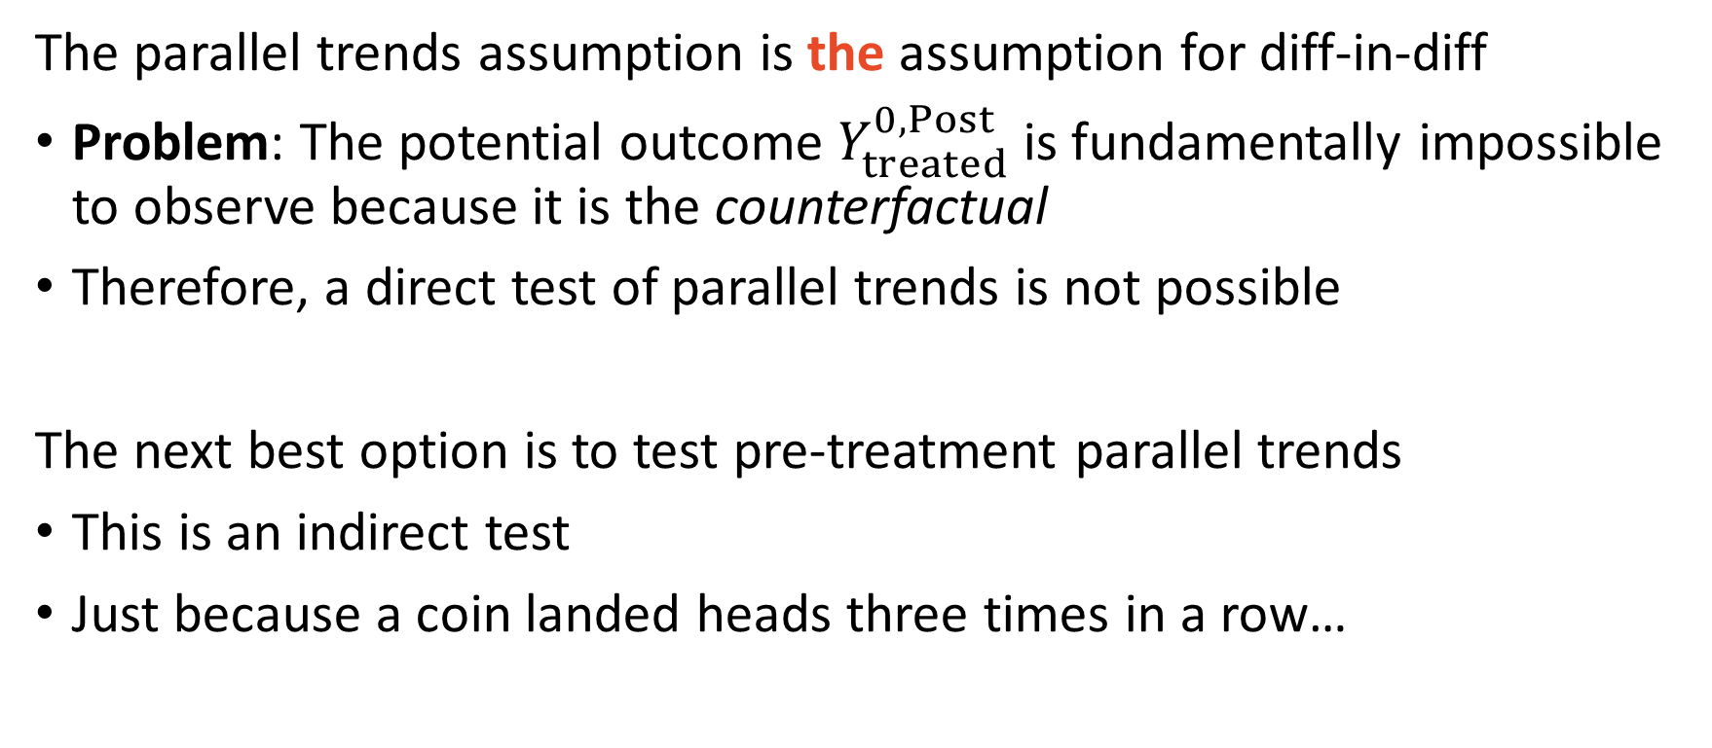
Parallel pre-trends is necessary but not sufficient
The parallel trends assumption is the assumption for diff-in-diff
Problem: The potential outcome $Y_{treated}^{0,Post}$ is fundamentally impossible to observe because it is the counterfactual
Therefore, a direct test of parallel trends is not possible
The next best option is to test pre-treatment parallel trends
This is an indirect test
Just because a coin landed heads three times in a row…

Slide 6
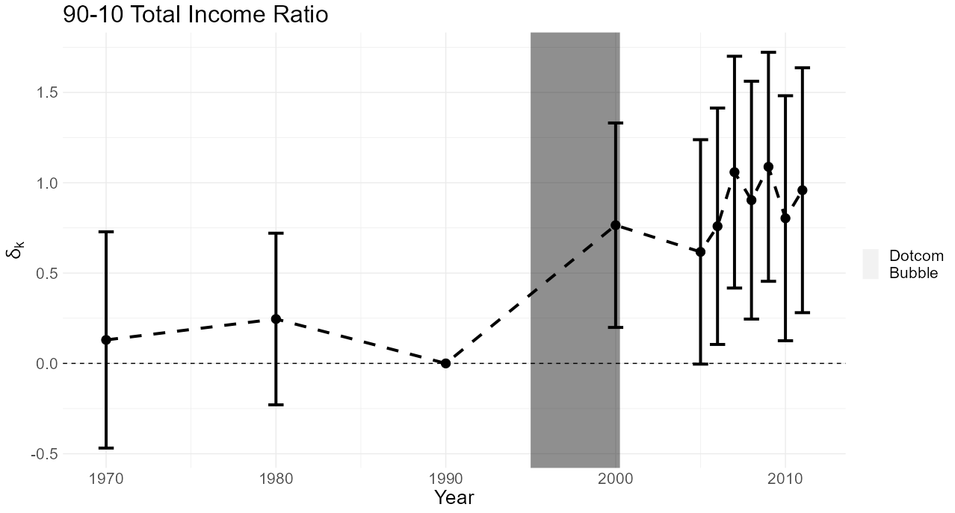
An event study figure

Slide 7
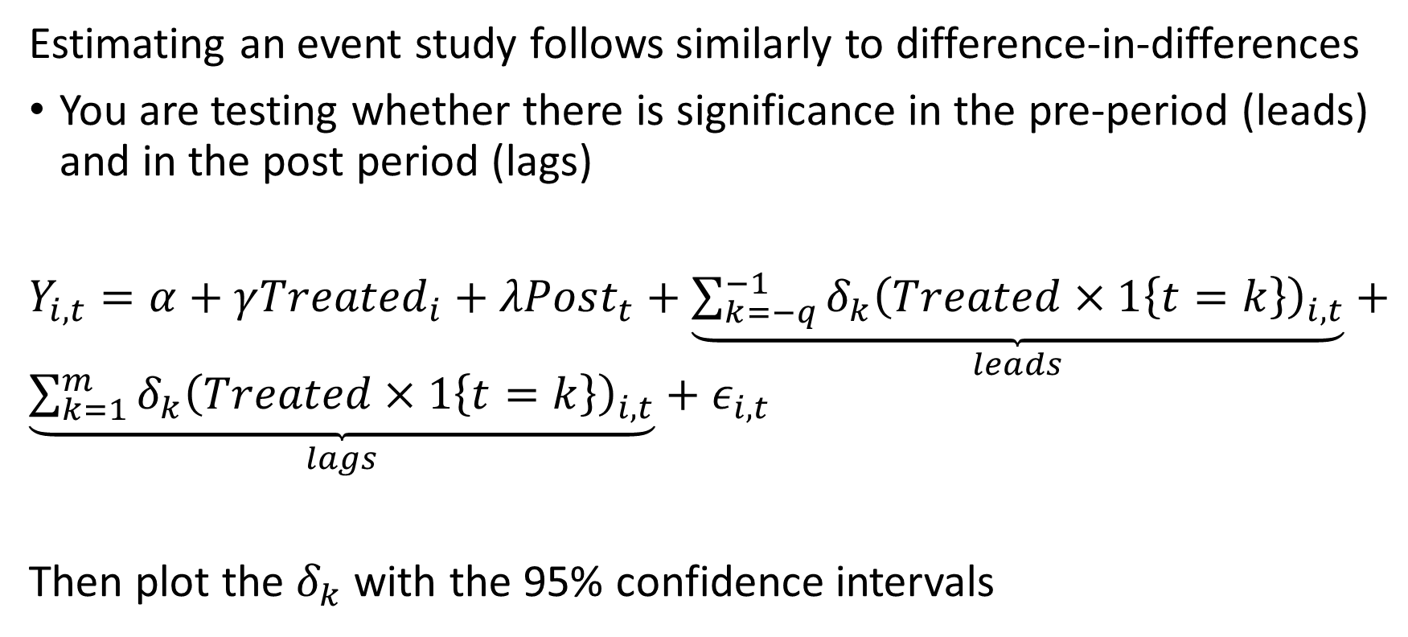
Estimating an event study
Estimating an event study follows similarly to difference-in-differences
You are testing whether there is significance in the pre-period (leads) and in the post period (lags)
$Y_{i,t}=α+γ{Treated}_{i}+λPost_{t}+\underset{leads}{\underbrace{\sum_{k=−q}^{−1}{δ_{k}{\left(Treated×1\left\{t=k\right\}\right)}_{i,t}}}}+\underset{lags}{\underbrace{\sum_{k=1}^{m}{δ_{k}{\left(Treated×1\left\{t=k\right\}\right)}_{i,t}}}}+ε_{i,t}$
Then plot the $δ_{k}$ with the 95% confidence intervals

Slide 8
Another caution about parallel pre-trends
Parallel pre-trends is the first half of the parallel trends assumption
You can never observe the (perhaps more important) second half
Additional checks for researchers to explore
Can observational units endogenously select treatment?
Is there a presence of omitted variable bias?
What sources of selection bias could there be?
Are there any open backdoor paths?

Slide 9
Placebo Checks
Ruling out stories that threaten identification

Slide 10
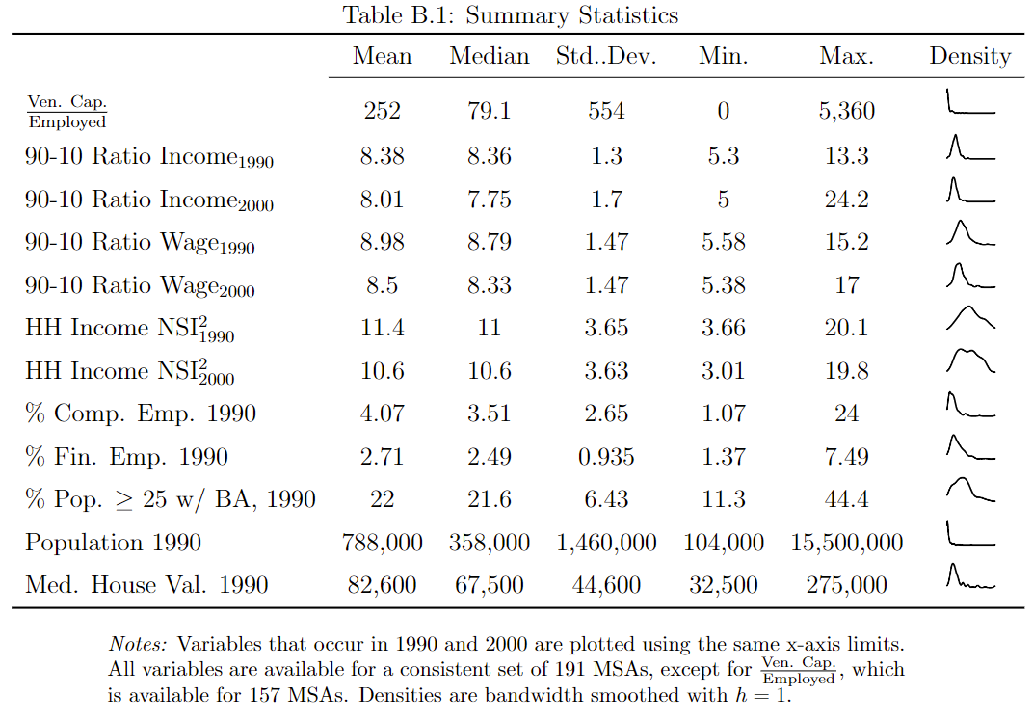
Data from natural experiments are not cut-and-dry

Slide 11
Use placebo checks to validate your design
Natural experiments do not occur in a lab
Events are always happening in the economy that could confound your results
Suggested robustness checks for diff-in-diff internal validity:
Remove observations most likely to respond to treatment (significant results)
Lag outcome variable (null results)
Try reasonable alternative treatment specifications (null results)
Test other outcomes that support or violate your story
Placebo robustness checks should be used in any empirical design (IV, RDD, etc.)

Slide 12
Differential exposure difference-in-differences
Nonbinary treatment assignment

Slide 13
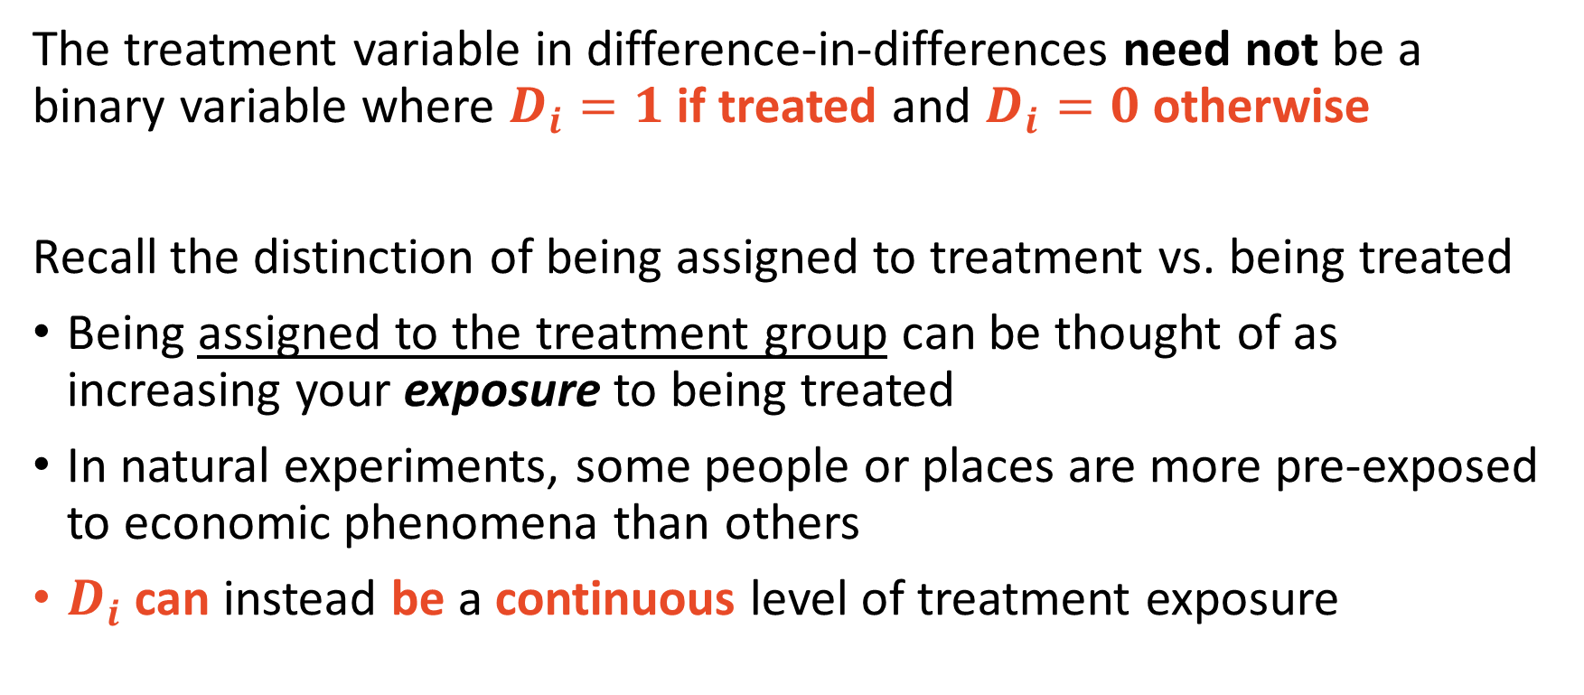
Treatment assignment can be nonbinary
The treatment variable in difference-in-differences need not be a binary variable where $D_{i}=1$ if treated and $D_{i}=0$ otherwise
Recall the distinction of being assigned to treatment vs. being treated
Being assigned to the treatment group can be thought of as increasing your exposure to being treated
In natural experiments, some people or places are more pre-exposed to economic phenomena than others
$D_{i}$ can instead be a continuous level of treatment exposure

Slide 14
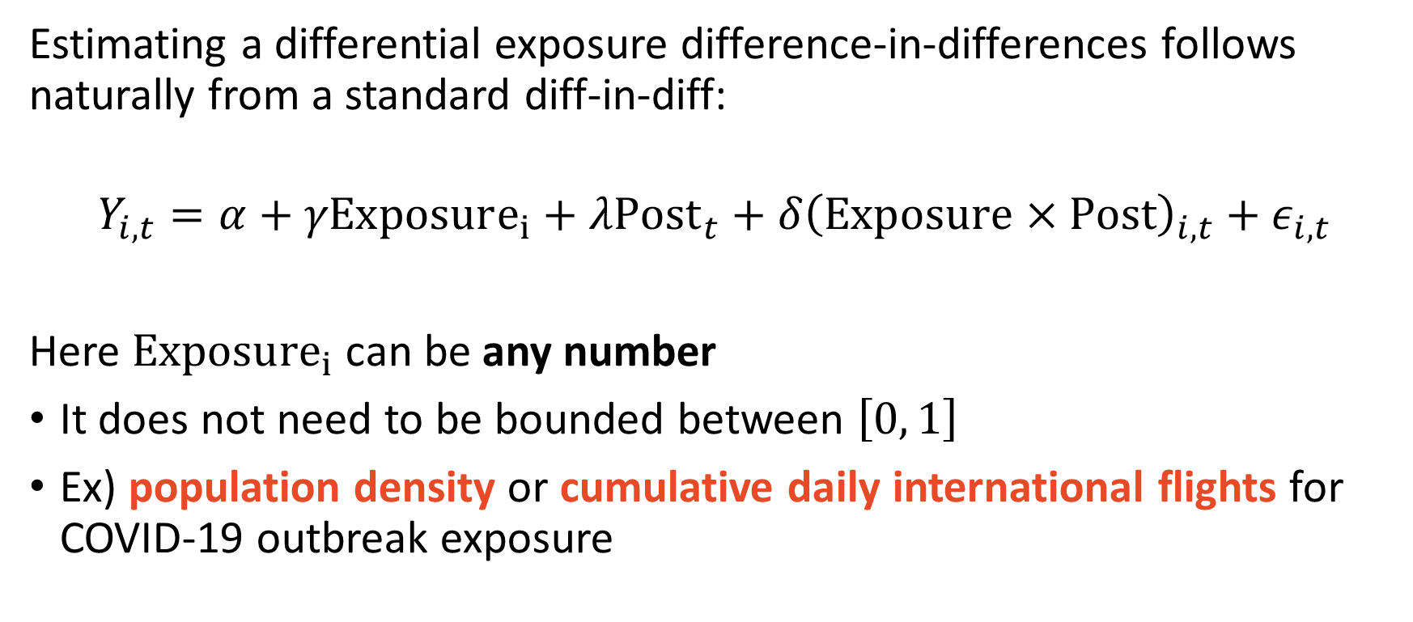
Difference-in-differences regression equation
Estimating a differential exposure difference-in-differences follows naturally from a standard diff-in-diff:
$$Y_{i,t}=α+γExposure_{i}+λPost_{t}+δ{\left(Exposure×Post\right)}_{i,t}+ε_{i,t}$$
Here ${Exposure}_{i}$ can be any number
It does not need to be bounded between $\left[0, 1\right]$
Ex) population density or cumulative daily international flights for COVID-19 outbreak exposure

Slide 15
“The Role of High-Skill Labor Demand on Spatial Income Inequality: Evidence from the Dotcom Bubble”
Does an increase high-skilled worker demand increase income inequality?

Slide 16
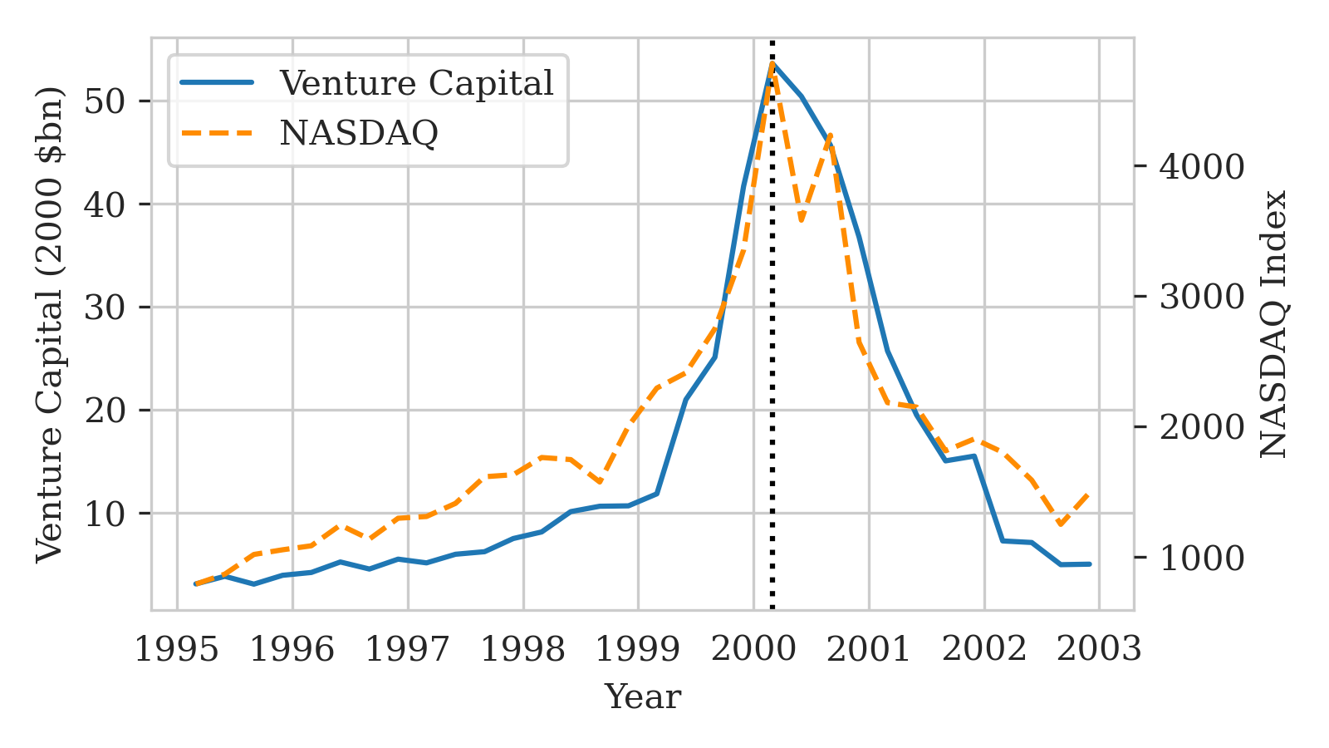
Setting: The Dotcom Bubble
From 1995Q1 – 2000Q1
NASDAQ increased 500%
15 year high
Venture capital increased 1,600%
TBD
Funded high-skilled workers in computer-related industries

Slide 17
The Dotcom bubble-income inequality DAG
House
prices
Population
Finance employment
?
?
Income inequality
Dotcom
Bubble
Computer employment
BA share

Slide 18
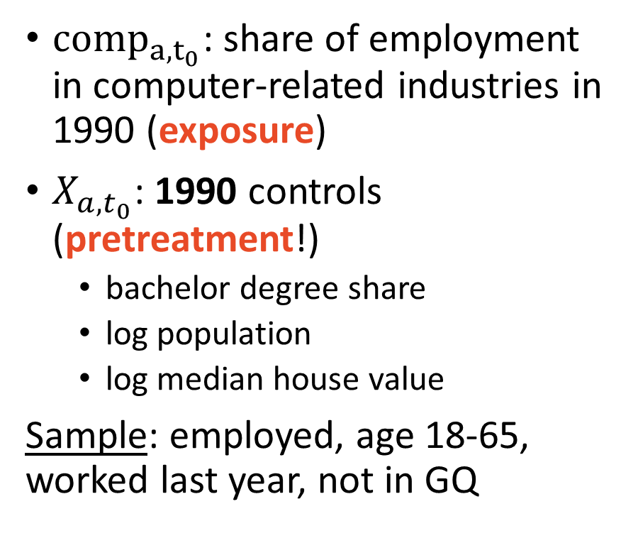
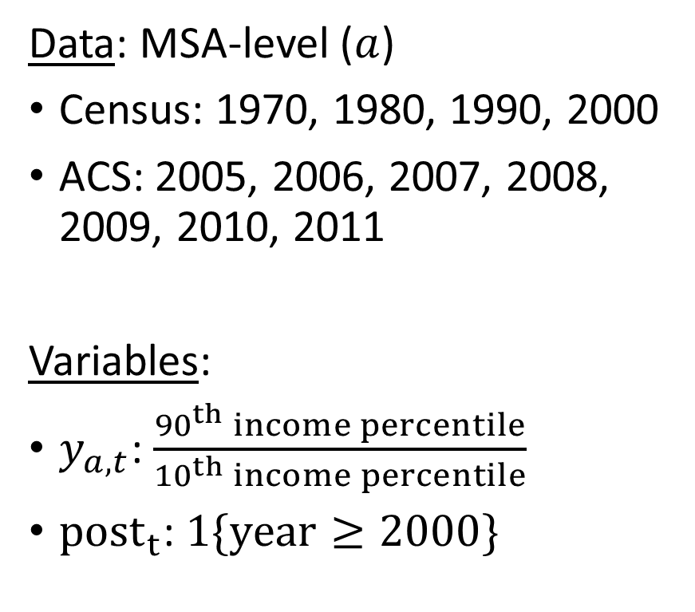
Data sources and variable definitions
Data: MSA-level ($a$)
Census: 1970, 1980, 1990, 2000
ACS: 2005, 2006, 2007, 2008, 2009, 2010, 2011
Variables:
$y_{a,t}$: $\frac{{90}^{th} income percentile}{{10}^{th} income percentile}$
${post}_{t}$: $1\{year≥2000\}$
${comp}_{a,t_{0}}$: share of employment in computer-related industries in 1990 (exposure)
$X_{a,t_{0}}$: 1990 controls (pretreatment!)
bachelor degree share
log population
log median house value
Sample: employed, age 18-65, worked last year, not in GQ

Slide 19
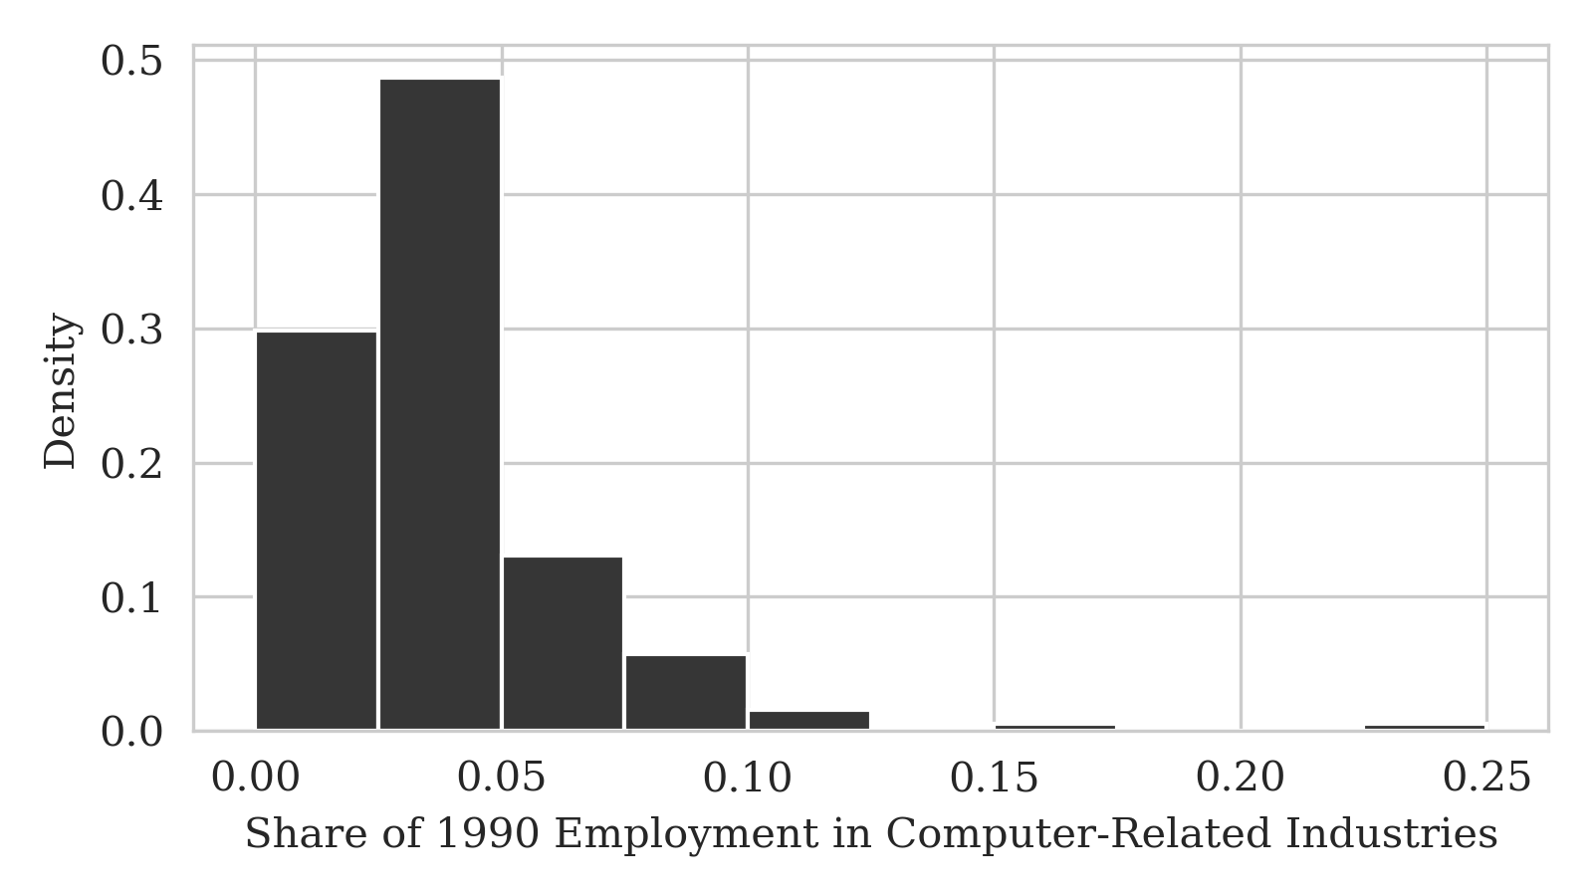
The distribution of differential exposure
Exposure is right-skewed
log transformation
San Jose, CA MSA (24%)
Binghamton, NY MSA (16%)
Threat: is silicon valley driving the results?

Slide 20
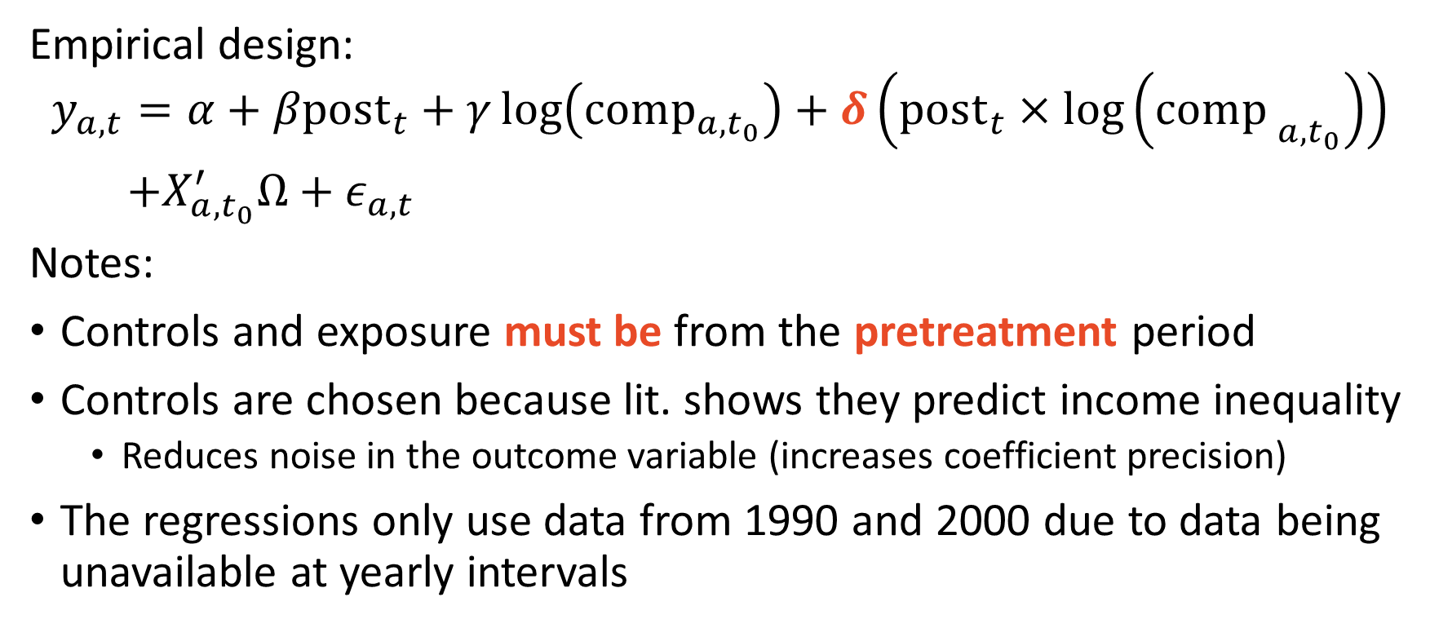
The empirical specification
Empirical design:
$$y_{a,t}=α+βpost_{t}+γ\log\left(comp_{a,t_{0}}\right)+δ\left(post_{t}×\log\left(com{p_{ }}_{a,t_{0}}\right)\right)$$
$+X_{a,t_{0}}^{′}Ω+ε_{a,t}$
Notes:
Controls and exposure must be from the pretreatment period
Controls are chosen because lit. shows they predict income inequality
Reduces noise in the outcome variable (increases coefficient precision)
The regressions only use data from 1990 and 2000 due to data being unavailable at yearly intervals

Slide 21
Findings of the paper
Overview of findings:
A 1% increase in exposure increased
Total income inequality by 9%
Wage income inequality by 6%
Capital income explains 50% of the total income vs. wage income gap
Changes to income inequality could be from changing incomes or changing population
No evidence is found supporting in-migration to exposed MSAs
No evidence is found suggesting an impact on housing markets

Slide 22
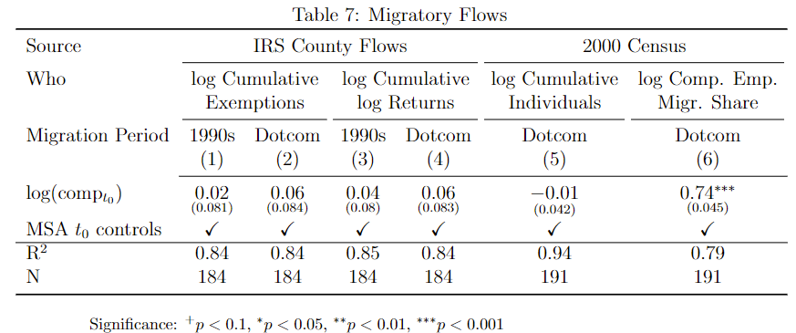
Tightly estimated zeros can be a good thing

Slide 23
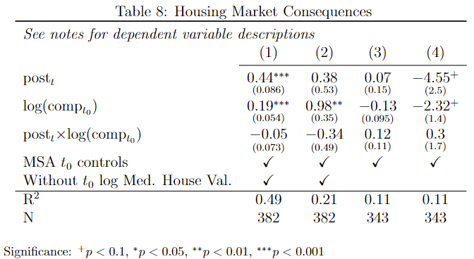
Not to be confused with noisy zeros

Slide 24



Researchers are detectives

Slide 25
Robustness checks
The research question is about high-skill demand, not stock returns
Ruled out return to finance workers by using as placebo exposure
Ruled out a return to college educated in general (not just those in computer-related employment) by regressing outcome college-gap
Ruled out dominant silicon valley by removing it from a specification
Supported parallel trends by lagging outcome variable

Slide 26
Away we go!

